Slide 1
What’s In Your Cart?
Network Analytics with Grocery Data
Ali Khan, David Gong, Madeleine Cope, Spandan Pal, Teja Sirigina, Raghav Vaidya, Teagan Milford

Slide 2
TABLE OF CONTENTS
01
Introduction
04
Visualization
02
Data
05
Recommendation System
03
06
Cleaning
Conclusion

Slide 3
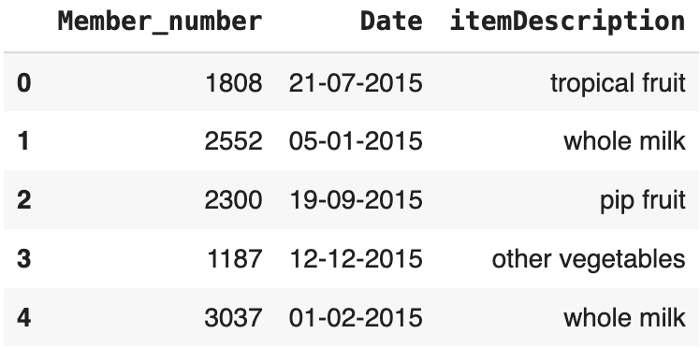
THE DATASET
KAGGLE
DATE
MEMBER ID
ITEM DESCRIPTION

Slide 4
THE GOAL
USER 1
USER 2
PRODUCT 1
PRODUCT 2
PRODUCT 3

Slide 5
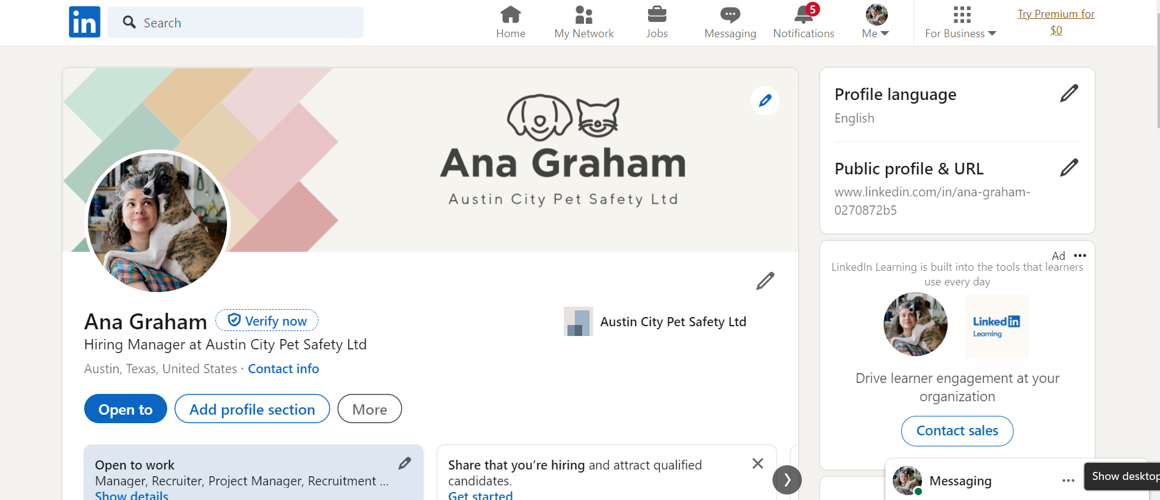
DATA CLEANING
LinkedIn
r/FemaleFashionAdvice
r/Handbags
r/Legal Advice
Notes:
Linkedin coulnt log in
Fashion couldnt find information about alternative/cheaper brands and much of the information was in images
Legal advice had a lot of information that would be great for a longer project

Slide 6
CATEGORIES
FRESH PRODUCE
BEVERAGES
DAIRY & EGGS
FROZEN & REFRIGERATED
BAKERY & CEREALS
HOUSEHOLD & PET
MEATS & SEAFOODS
MISCELLANEOUS

Slide 7
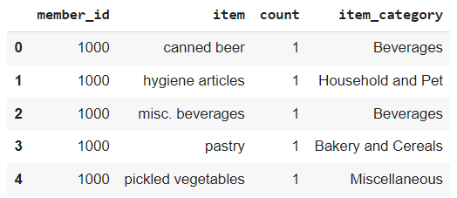
UPDATED DATASET
Member ID
ITEM
COUNT
ITEM CATEGORY

Slide 8
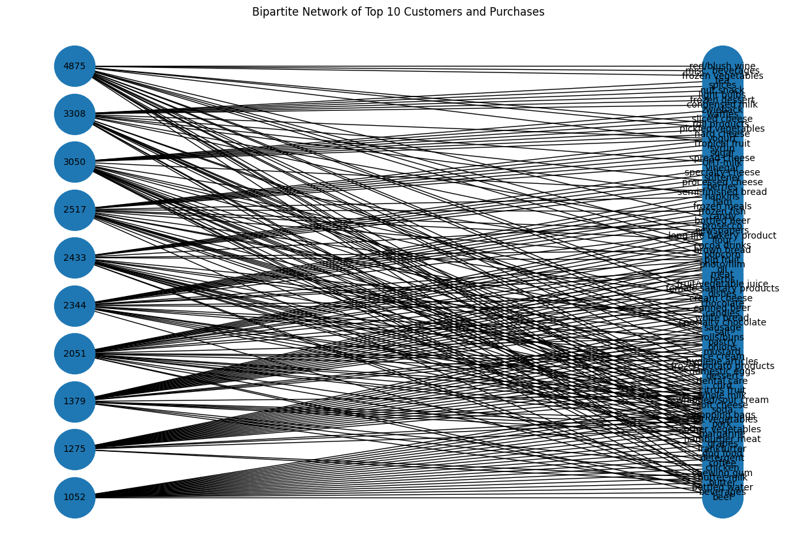
BIPARTIDE NETWORK OF TOP
10 USERS & PURCHASE FREQUENCY

Slide 9
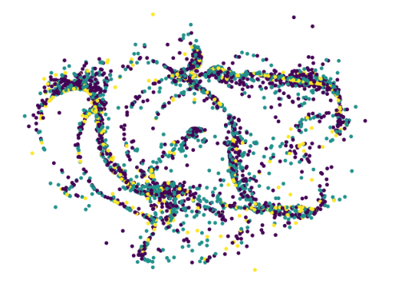
COMMUNITY CLUSTERING
There are no
strong clusters
Overall, we cannot confidently interpret
the clusters
This led to us approaching the data from another angle

Slide 10
Recommender System
User 1
User 2
User 3
Milk
Turkey
Grapes
Eggs
Bread
Cheese
Crackers

Slide 11
How to find similar users?
Maximizing Intersection Size
Cosine Similarity
Hit Rate: 22%
Hit Rate: 24%

Slide 12
Clustering of similar users
50% within cluster
50% out of cluster
Cluster 1
Cluster 1
Cluster2
User 1
User 2
User 1
User 2

Slide 13
Future Uses
Grocery online storefronts
E-commerce across industries
Trials and Samples
Can offer recommendations of items not typically bought by the user
Because the e-commerce area is growing, this could be a way for many industries to have a competitive advantage
Companies can use this logic to offer samples to customers that they actually may want to buy later

Slide 14
Thank You!

